Slide 1

Unit-01 Introduction to Python, Object and Data Structure
Python Programming(2301CS404)
Prof. Shruti R. Maniar
Computer Engineering Department
shruti.maniar@darshan.ac.in

Slide 2

Outline
Introduction to python
Features of python
Installing python
Hello World program using python
Indentations
Print() function
Input() function
Data types
Variables
Expressions
Functions
String
List
Tuple
Set
Dictionary
List Comprehension
Looping

Slide 3
Syllabus
Sr. No. | Unit
1 | Introduction to Python, Object and Data Structure
2 | Python Operators, Conditional and Looping Statements, Functions in Python
3 | File IO in Python, Exception handling
4 | Modules, Matplotlib
5 | Object Oriented Programming with Python
Reference Book:
Introduction to Computation and Programming Using Python
Core Python Programming by R. Nageswara Rao
Core Python Programming by Wesley J. Chun
Programming in Python 3 : A Complete Introduction to the Python Language

Slide 4
Python - Introduction

Slide 5

Introduction to Python
Python is an open source, interpreted, high-level, general-purpose programming language.
Python's design philosophy emphasizes code readability with its notable use of significant whitespace.
Python is dynamically typed and garbage-collected language.
Python was conceived in the late 1980s as a successor to the ABC language.
Python was Created by Guido van Rossum and first released in 1991.
Python 2.0, released in 2000,
introduced features like list comprehensions and a garbage collection system with reference counting.
Python 3.0 released in 2008 and current version of python is 3.13.0 (as of Nov 2024).
The Python 2 language was officially discontinued in 2020

Slide 6
Python - Features

Slide 7
Features of Python
Easy to use
Python is a high-level programming language that has English-like syntax. This makes it easier to read and understand the code.
Dynamically Typed Language
Python automatically assigns the data type during execution. The programmer doesn’t need to worry about declaring variables and their data types.
Vast Libraries Support
The standard library of Python is huge, you can find almost all the functions needed for your task. So, you don’t have to depend on external libraries.
Free and Open-Source
Python comes under the OSI approved open-source license. This makes it free to use and distribute.
The Python Software Foundation distributes pre-made binaries(precompiled versions of the Python interpreter and standard library) that are freely available for use on all major operating systems called CPython.
You can get CPython’s source-code, too. Plus, you can modify the source code and distribute it as allowed by CPython’s license.

Slide 8
Features of Python (cont..)
Portability
In many languages like C/C++, you need to change your code to run the program on different platforms. That is not the same with Python. You only write once and run it anywhere.
Python runs on all major operating systems like Microsoft Windows, Linux, and Mac OS X.
High-Level Language
Python looks more like a readable, human language than like a low-level language.
This gives you the ability to program at a faster rate.
Improved Productivity
Python is a very productive language. Due to the simplicity, developers can focus on solving the problem.
Interpreted Language
Python is an interpreted language which means that Python directly executes the code line by line. In case of any error, it stops further execution and reports back the error which has occurred.
It’s Safe
Python doesn’t have pointers like other C-based languages, making it much more reliable.
Along with that, errors never pass silently unless they’re explicitly silenced.
This allows you to see and read why the program crashed and where to correct your error.

Slide 9
Python - Installation

Slide 10
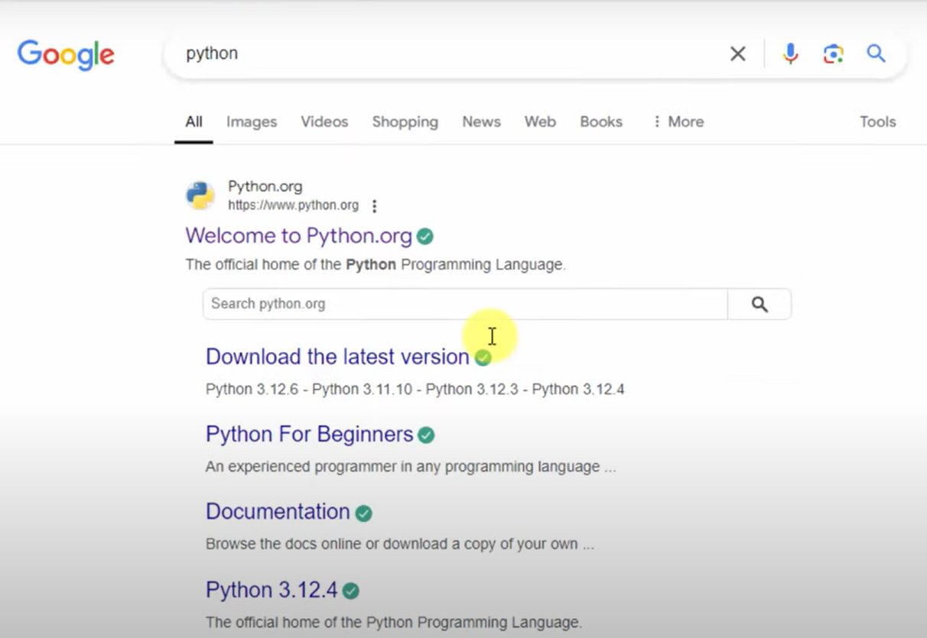
Step – 1 Search Python on Google

Slide 11
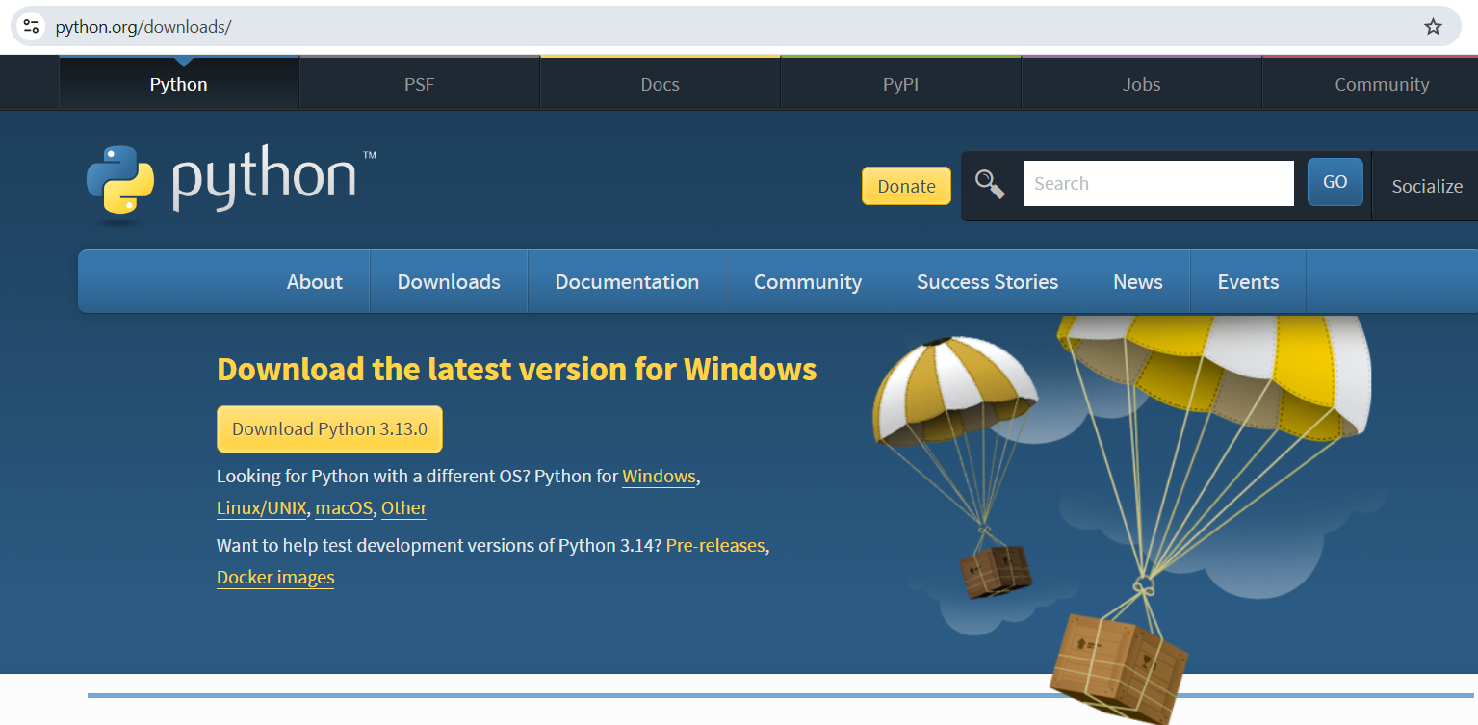
Step-2 Open python.org

Slide 12
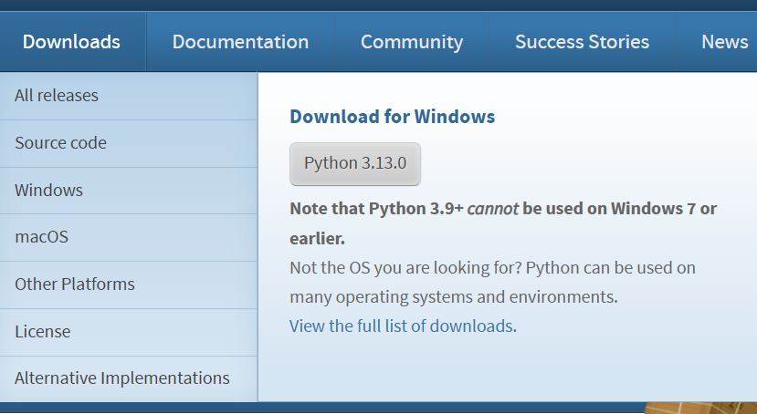
Step-3 Download the suitable installer

Slide 13
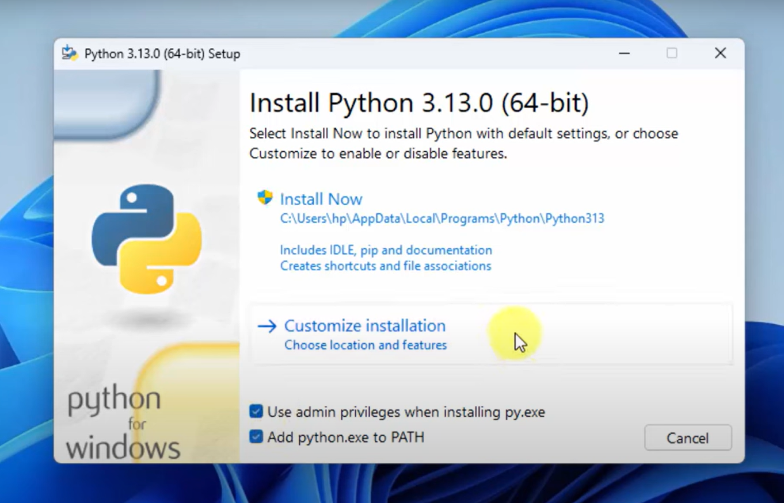
Step-4 Run .exe and Select Customize installation

Slide 14
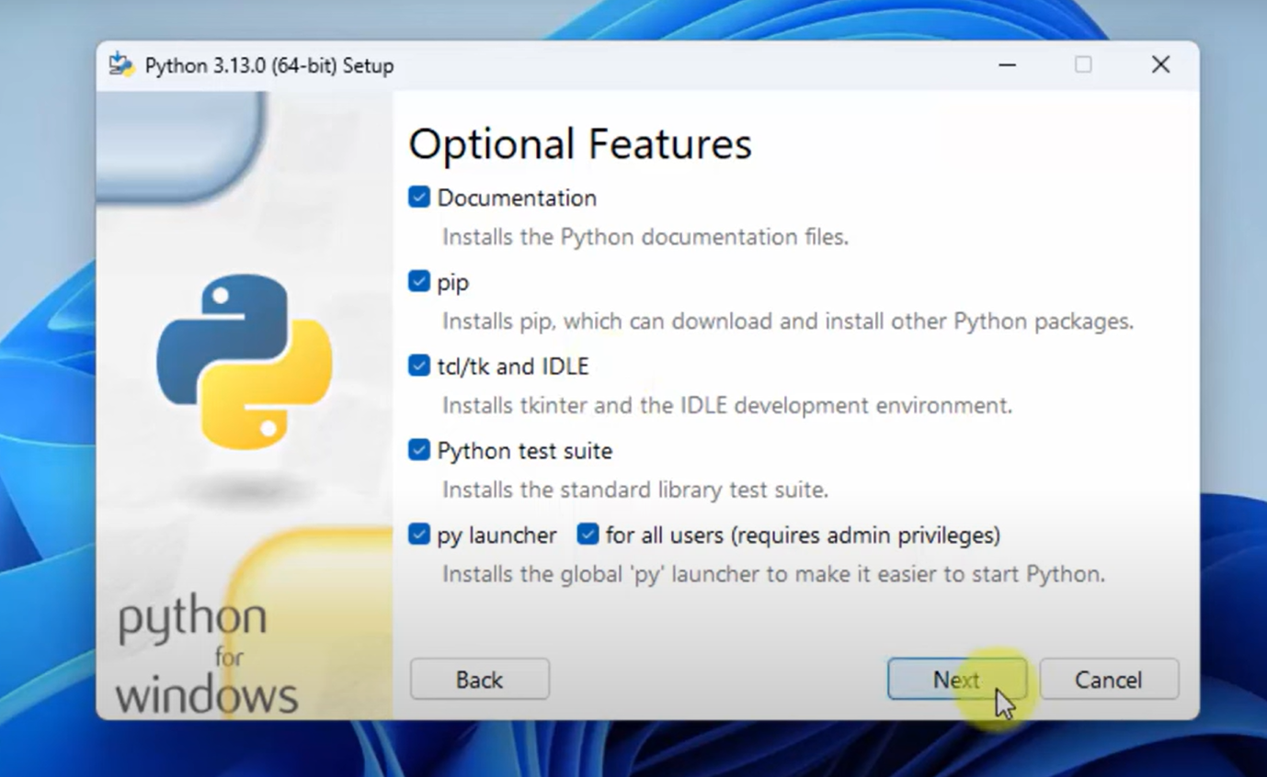
Step-5 Select all Optional Features

Slide 15
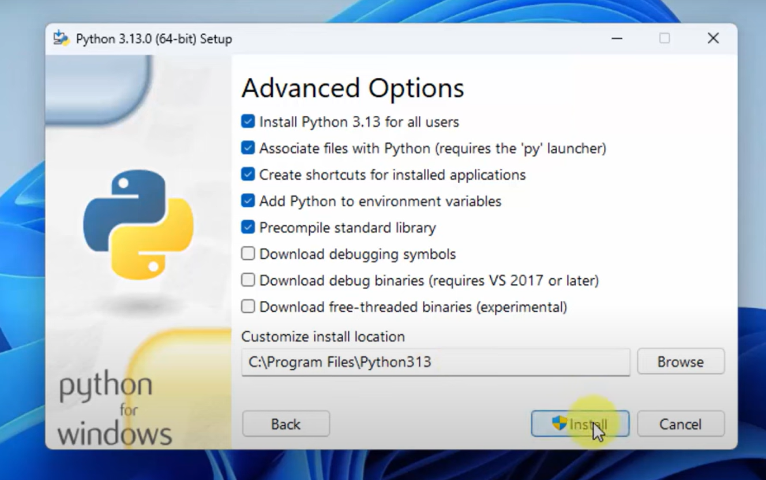
Step-6 Select Advanced Options

Slide 16
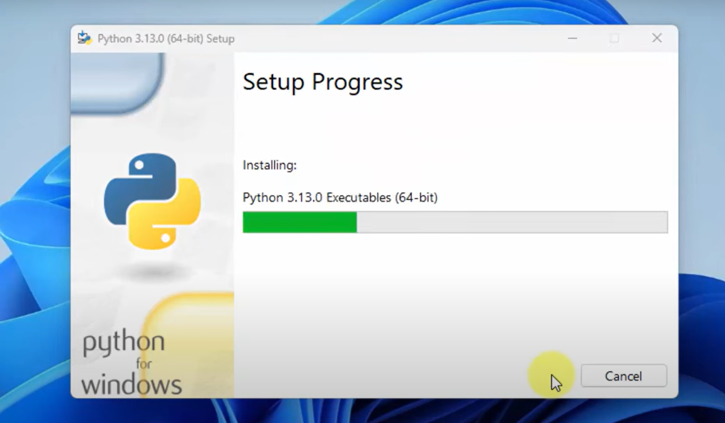
Step-7 Installation Started

Slide 17
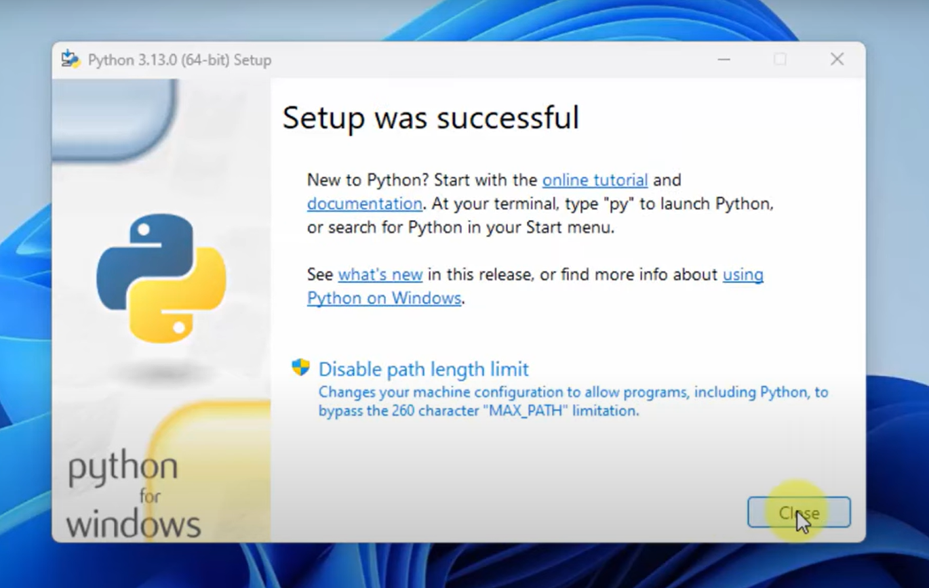
Step-8 Installation Completed

Slide 18
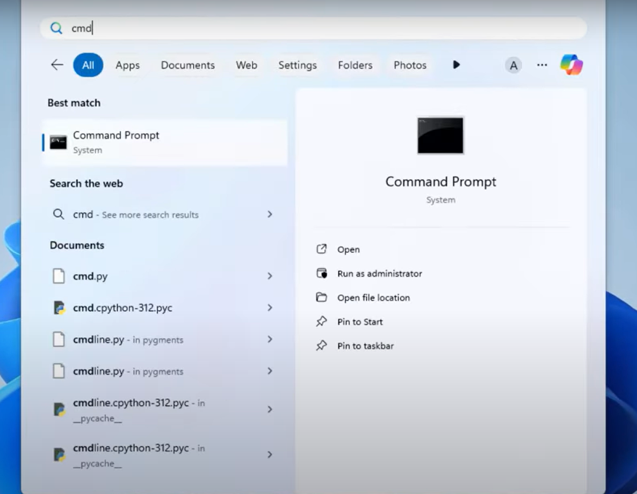
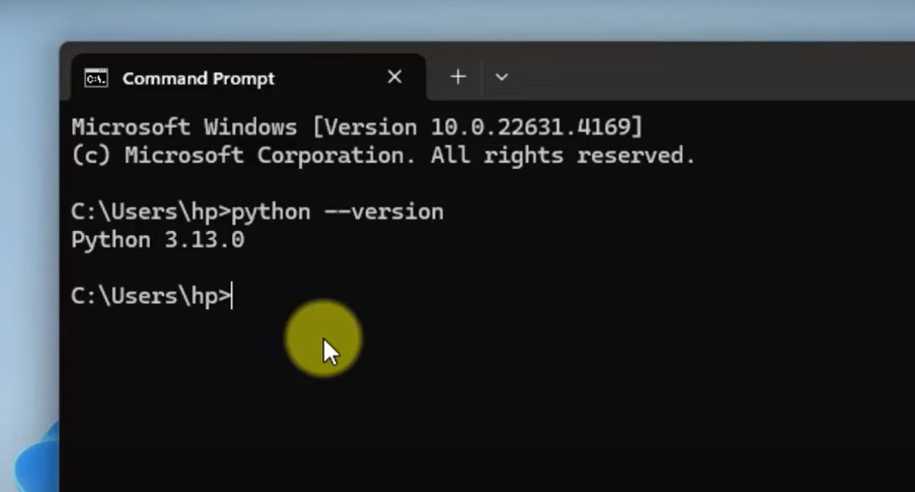
Verify Successful Installation

Slide 19
Installing Python for Linux
Command for installation :
sudo apt-get update
sudo apt-get install python3
To verify the installation :
python3 --version

Slide 20
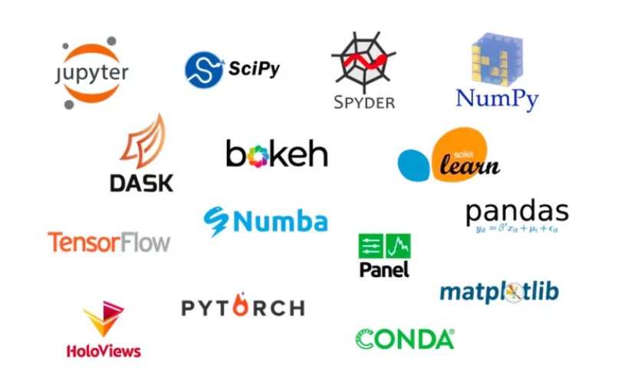
Anaconda for Python
Anaconda is a popular open-source distribution of the Python and R programming languages.
Anaconda comes packed with a suite of powerful tools designed to enhance your data science and machine learning workflow.
Following are some most useful ones:
Jupyter Notebook
Spyder
Rstudio
VS Code (Visual Studio Code)
Anaconda Navigator
TensorFlow, etc…
We will use Jupyter Notebook for doing interactive programming and getting immediate visualization.

Slide 21
Anaconda Installation

Slide 22
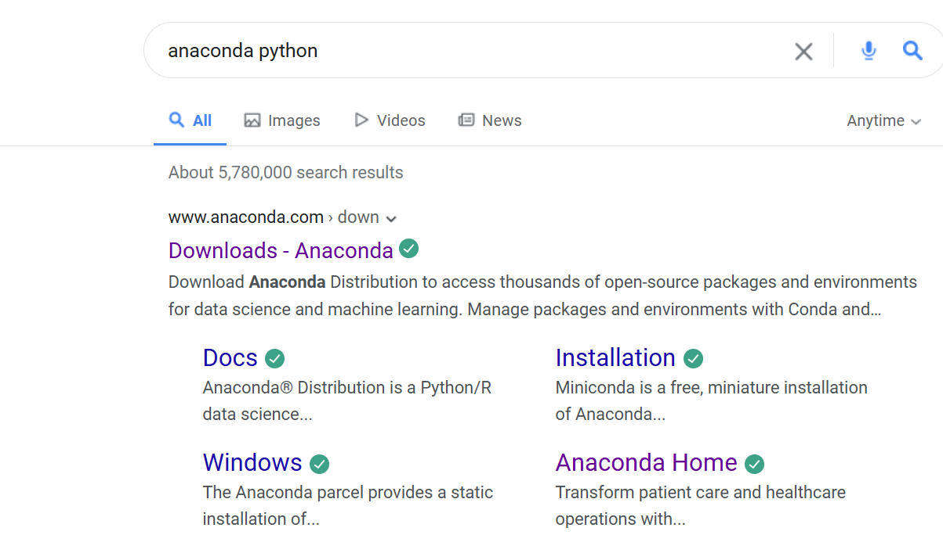
Step – 1 Search anaconda python

Slide 23

Step – 2 Download the Installer

Slide 24
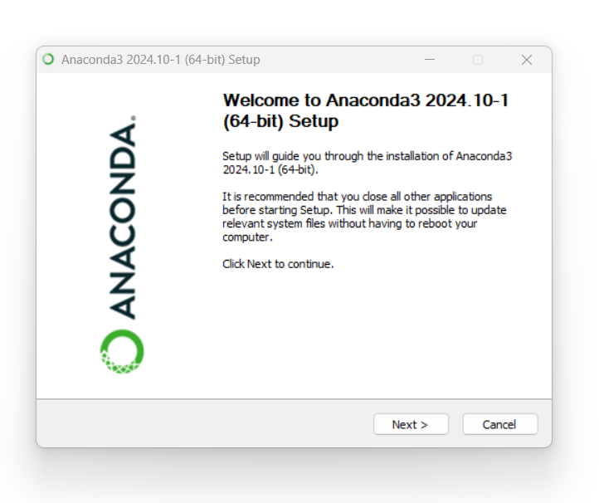
Step – 3 Follow the steps on wizard

Slide 25
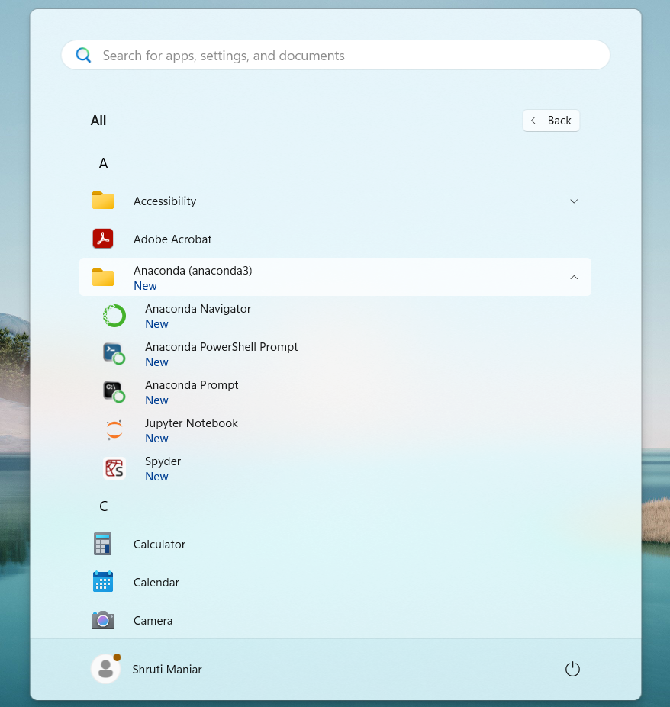
Step – 4 Verify the installation

Slide 26
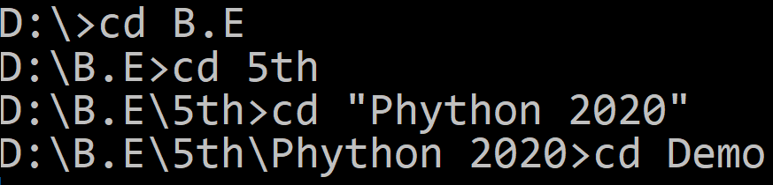
Hello World using Python
To write python programs, we can use any text editors or IDE (Integrated Development Environment).
Create new file in editor, save it as first.py (Extensions for python programs will be .py)
To run the python file open command prompt and change directory to where your python file is
Next, run python command (python filename.py)
first.py
Python line does not end with ;
1
print("Hello World from python")

Slide 27
Indentation

Slide 28
Indentation in Python
Indentation in general means indenting words or spaces or lines in the document to follow the styling rule for documentation.
Indentation in Python refers to the (spaces and tabs) that are used at the beginning of a statement.
The statements with the same indentation belong to the same group called a suite.
In many different programming languages like C, C++, Java, etc. use curly brackets or braces {} to define or to identify a block of code in the program, whereas in Python, it is done using the spaces or tabs, which is known as indentation and also it is generally known as 4 space rule in Pep8 documentation of rules for styling and designing the code for Python.
Example.py
1
2
3
4
5
if Condition:
print("True")
else:
print("False")
IndentationError: unindent does not match any outer indentation level

Slide 29
Input & Output Function

Slide 30
print() Function
The print() function prints the specified message to the screen, or other standard output device.
The object will be converted into a string before written to the screen.
Syntax
1
print(object(s), sep=separator, end=end)
Parameter Name | Description
Object(s) | Any number of objects. Will be converted into string before printing.
sep | Optional. Specify how to separate the objects, if there is more than one. Default is ' '
end | Optional. Specify what to print at the end. Default is '\n'

Slide 31
input() Function
The input() function allows user to enter values.
Whatever you enter as input, the input function converts it into a string. If you enter an integer value still input() function convert it into a string.
Syntax
1
input(prompt)
Parameter Name | Description
prompt(s) | A String, representing a default message before the input.

Slide 32
Example
Example.py
Output
1
2
3
4
5
6
7
9
10
11
12
13
14
a = 4
str = input("Enter your name = ")
num = int(input("Enter Number = "))
print(4,5)
print("Hello","World")
print("Hello","World",sep="-")
print("Hello","DU",sep="-",end=" ")
print("Hello" + "DU ")
print("a = ", a,end=", ")
print("num = ", num)
print("your Name ="+ str)
print("Your Name ",str,sep="=")
Enter your name = ABC
Enter Number = 10
4 5
Hello World
Hello-World
Hello-DU HelloDU
a = 4, num = 10
your Name =ABC
Your Name =ABC

Slide 33
Program 1
WAP to develop simple calculator in python.
Example1.py
1
2
3
4
5
6
number1 = int(input("Enter first number: "))
number2 = int(input("Enter second number: "))
print(number1, "+", number2, "=", number1+number2)
print(number1, "*", number2, "=", number1*number2)
print(number1, "-", number2, "=", number1-number2)
print(number1, "/", number2, "=", number1/number2)
Output
Enter first number: 3
Enter second number: 3
3 + 3 = 6
3 * 3 = 9
3 - 3 = 0
3 / 3 = 1.0

Slide 34
Program 2
WAP to calculate simple interest.
Example2.py
1
2
3
4
5
P = int(input("Enter P: "))
R = int(input("Enter R: "))
T = int(input("Enter N: "))
Simple_interest = (P * R * T) / 100
print("The simple interest is:", Simple_interest)
Output
Enter P: 10000
Enter R: 5
Enter N: 1
The simple interest is: 500.0

Slide 35
Program 3
WAP to calculate area of circle.
Example3.py
1
2
3
4
PI = 3.14
r = float(input("Enter the radius of a circle:"))
area = PI * r * r
print("Area of a circle = %.2f" %area)
Output
Enter the radius of a circle:100
Area of a circle = 31400.00

Slide 36
Datatypes

Slide 37
Type | Class | Description
Data Types
Integer | int | Whole number such as 0,1,5, -5 etc..
Float | float | Numbers with decimal points such as 1.5, 7.9, -8.2 etc..
Complex Number | complex | Complex number (real_part)+(imaginary_part)j such as 2 + 3j
String | str | Sequence of character (Ordered) such as “darshan”, ‘college’, “રાજકોટ” etc..
Boolean | bool | Logical values indicating Ture or False (T and F here are capital in python)
Data Structures
List | list | Ordered Sequence of objects, will be represented with square brackets [ ] Example : [ 18, “darshan”, True, 102.3 ]
Tuple | Tup | Ordered immutable sequence of objects, will be represented with round brackets ( ) Example : ( 18, “darshan”, True, 102.3 )
Set | Set | Unordered collection of unique objects, will be represented with the curly brackets { } Example : { 18, “darshan”, True, 102.3 }
Dictionary | Dict | Ordered key : value pair of objects , will be represented with curly brackets { } Example : { “college”: “darshan”, “code”: “054” }

Slide 38
Variable

Slide 39
Variable in Python
A Python variable is a reserved memory location to store values.
Unlike other programming languages, Python has no command for declaring a variable.
A variable is created the moment you first assign a value to it.
Python uses Dynamic Typing so,
We need not to specify the data types to the variable as it will internally assign the data type to the variable according to the value assigned.
we can also reassign new value of the different data type to the same variable, variable data type will change to new data type automatically.
We can check the current data type of the variable with type(variablename) in-built function.
Rules for Variable Name :
Variable Name must begin with Letter or Underscore(_), it can not start with digit.
Remaining characters of the Variable Name can be letters, numbers or Underscore.
Spaces and Special Characters are not allowed.
Python Keywords are not allowed to be a Variable Name.
Variable Names are Case-Sensitive.

Slide 40
Example of Python Variable
Example :
demo.py
1
2
3
4
5
6
7
8
9
10
x = 10
print(x)
print(type(x))
y = 123.456
print(y)
x = "darshan insitute of engneering and technology"
print(x)
print(type(x))
Reassign same variable to hold different data type
Run in terminal
1
python demo.py
Output
1
2
3
4
5
10
<class 'int'>
123.456
Darshan institute of engineering and technology
<class 'str'>

Slide 41
Comments

Slide 42
Comments
In Python, comments are used to explain code and make it more readable.
They are ignored by the Python interpreter when the code is executed.
There are two main types of comments in Python:
Single-line Comments:
These are created using the # symbol.
Everything after the #, on that line is considered to be a comment.
Multi-line Comments:
These can be done using triple quotes (‘ ‘ ’ or “ ” ”).
# This is Single-line Comment
print("Hello World..!!") #This comment is on the same line
''' This is Multiline Comment
that spans multiple lines
'''
print("Hello World..!!")
""" Another multiline comments
using triple quotes
"""

Slide 43
Tokens

Slide 44
Tokens
In Python, a Token is the smallest unit of a program.
Tokens are the building blocks of a Python program. Here are the main types of tokens in Python:
Keywords : Reserved words that have special meaning and cannot be used as identifiers. Example : If, else, for, while, try, except, etc.
Identifiers: Names given to variables, functions, classes, and other objects.
Literals: Constant values used in programs. They can be of various types (string, numeric, boolean, etc..)
Operators: Symbols that perform operations on one or more operands. Example : +,-,*,/,==, !=,etc.
Delimiters: Symbols used to separate code elements. Example : (),[],{} and comma(,).
Comments: Text added to the code for documentation purposes, which is ignored by the Python interpreter. Example : #, ’ ’ ’ ,” ” ”

Slide 45
Tokens
# This is a comment
x = 42 # x is identifier , 42 is literal
if x > 0: # if is keyword, > is operator, 0 is literal
print("x is positive") # print is function, "x is positive" is string literal

Slide 46
String

Slide 47
String in Python
String is Ordered Sequence of character such as “darshan”, ‘college’, “રાજકોટ” etc..
Strings are arrays of characters representing Unicode characters.
String can be represented as single, double or triple quotes.
String with triple Quotes allows multiple lines.
String in Python is immutable.
Square brackets can be used to access elements of the string, Ex. “Darshan”[1] = a, characters can also be accessed with reverse index like “Darshan”[-1] = n.
String index
x = " D a r s h a n "
index = 0 1 2 3 4 5 6
Reverse index = -7 -6 -5 -4 -3 -2 -1

Slide 48
String Slicing
We can get the substring in python using string slicing, we can specify start index, end index and steps (colon separated) to slice the string.
syntax
x = 'darshan institute of engineering and technology, rajkot, gujarat, INDIA'
subx = x[startindex:endindex:steps]
endindex will not be included in the substring
strslicedemo.py
1
2
3
4
5
6
7
8
9
10
11
x = 'darshan institute of engineering and technology, rajkot, gujarat, INDIA'
subx1 = x[0:7]
subx2 = x[49:55]
subx3 = x[66:]
subx4 = x[::2]
subx5 = x[::-1]
print(subx1)
print(subx2)
print(subx3)
print(subx4)
print(subx5)
Output : darshan
Output : rajkot
Output : INDIA
Output : drhnisiueo niern n ehooy akt uaa,IDA
Output : AIDNI ,tarajug ,tokjar ,ygolonhcet dna gnireenigne fo etutitsni nahsrad

Slide 49
String Methods
Python has lots of built-in methods that you can use on strings, we are going to cover some frequently used methods for string like
len()
count()
title(), lower(), upper()
istitle(), islower(), isupper()
find(), rfind(), replace()
index(), rindex()
Methods for validations like
isalpha(), isalnum(), isdecimal(), isdigit()
strip(), lstrip(), rstrip()
split()
Etc..
Note : len() is not the method of the string but can be used to get the length of the string
lendemo.py
Output : 7 (length of “Darshan”)
1
2
x = "Darshan"
print(len(x))

Slide 50
String Methods (cont.)
count() method will returns the number of times a specified value occurs in a string.
title(), lower(), upper() will returns capitalized, lower case and upper case string respectively.
countdemo.py
1
2
3
x = "Darshan"
ca = x.count('a')
print(ca)
Output : 2 (occurrence of ‘a’ in “Darshan”)
changecase.py
1
2
3
4
5
6
7
x = "darshan Institute, rajkot"
c = x.title()
l = x.lower()
u = x.upper()
print(c)
print(l)
print(u)
Output : Darshan Institute, Rajkot
Output : darshan institute, rajkot
Output : DARSHAN INSTITUTE, RAJKOT

Slide 51
String Methods (cont.)
istitle(), islower(), isupper() will returns True if the given string is capitalized, lower case and upper case respectively.
strip() method will remove whitespaces from both side of the string and returns the string.
rstrip() and lstrip() will remove whitespaces from right and left side respectively.
checkcase.py
1
2
3
4
5
6
7
x = 'darshan institute, rajkot'
c = x.istitle()
l = x.islower()
u = x.isupper()
print(c)
print(l)
print(u)
Output : False
Output : True
Output : False
stripdemo.py
1
2
3
x = ' Darshan '
f = x.strip()
print(f)
Output : Darshan (without space)

Slide 52
String Methods (cont.)
find() method will search the string and returns the index at which they find the specified value
rfind() will search the string and returns the last index at which they find the specified value
Note : find() and rfind() will return -1 if they are unable to find the given string.
replace() will replace str1 with str2 from our string and return the updated string
finddemo.py
1
2
3
x = 'darshan institute, rajkot, india'
f = x.find('in')
print(f)
Output : 8 (occurrence of ‘in’ in x)
rfinddemo.py
1
2
3
x = 'darshan institute, rajkot, india'
r = x.rfind('in')
print(r)
Output : 27 (last occurrence of ‘in’ in x)
replacedemo.py
1
2
3
x = 'darshan institute, rajkot, india'
r = x.replace('india','INDIA')
print(r)
Output : “darshan institute, rajkot, INDIA”

Slide 53
String Methods (cont.)
index() method will search the string and returns the index at which they find the specified value, but if they are unable to find the string it will raise an exception.
rindex() will search the string and returns the last index at which they find the specified value , but if they are unable to find the string it will raise an exception.
Note : find() and index() are almost same, the only difference is if find() is unable to find the string it will return -1 and if index() is unable to find the string it will raise an exception.
indexdemo.py
1
2
3
x = 'darshan institute, rajkot, india'
f = x.index('in')
print(f)
Output : 8 (occurrence of ‘in’ in x)
rindexdemo.py
1
2
3
x = 'darshan institute, rajkot, india'
r = x.rindex('in')
print(r)
Output : 27 (last occurrence of ‘in’ in x)

Slide 54
String Methods (cont.)
isalnum() method will return true if all the characters in the string are alphanumeric (i.e either alphabets or numeric).
isalpha() and isnumeric() will return true if all the characters in the string are only alphabets and numeric respectively.
isdecimal() will return true is all the characters in the string are decimal.
Note : isnumeric() and isdigit() are almost same, you suppose to find the difference as Home work assignment for the string methods.
isalnumdemo.py
1
2
3
x = 'darshan123'
f = x.isalnum()
print(f)
Output : True
isdecimaldemo.py
1
2
3
x = '123.5'
r = x.isdecimal()
print(r)
Output : False

Slide 55
String Formatting
str.format() is one of the string formatting methods in Python3, which allows multiple substitutions and value formatting.
This method lets us concatenate elements within a string through positional formatting.
We can specify multiple parameters to the function
strformat.py
1
2
3
4
x = '{} institute, rajkot'
y = x.format('darshan')
print(y)
print(x.format('ABCD'))
Output : darshan institute, rajkot
Inline function call
Output : ABCD institute, rajkot
strformat.py
1
2
3
4
x = '{} institute, {}'
y = x.format('darshan','rajkot')
print(y)
print(x.format('ABCD','XYZ'))
Output : darshan institute, rajkot
Inline function call
Output : ABCD institute, XYZ

Slide 56
String Formatting (cont.)
We can specify the order of parameters in the string
We can also specify alias within the string to specify the order
We can format the decimal values using format method
strformat.py
1
2
3
4
x = '{1} institute, {0}'
y = x.format('darshan','rajkot')
print(y)
print(x.format('ABCD','XYZ'))
Output : rajkot institute, darshan
Inline function call
Output : XYZ institute, ABCD
strformat.py
1
2
x = '{collegename} institute, {cityname}'
print(x.format(collegename='darshan',cityname='rajkot'))
Output : darshan institute, rajkot
strformat.py
1
2
3
per = (438 / 500) * 100
x = 'result = {r:3.2f} %'.format(r=per)
print(x)
Output : result = 87.60 %
width
precision

Slide 57
Data Structures in Python

Slide 58
Data Structures in Python
There are four built-in data structures in Python - list, dictionary, tuple and set.
Lets explore all the data structures in detail…
Name | Type | Description
List | list | Ordered Sequence of objects, will be represented with square brackets [ ] Example : [ 18, “darshan”, True, 102.3 ]
Dictionary | dict | Ordered key : value pair of objects , will be represented with curly brackets { } Example : { “college”: “darshan”, “code”: “054” }
Tuple | tup | Ordered immutable sequence of objects, will be represented with round brackets ( ) Example : ( 18, “darshan”, True, 102.3 )
Set | set | Unordered collection of unique objects, will be represented with the curly brackets { } Example : { 18, “darshan”, True, 102.3 }

Slide 59
List
List is a mutable ordered sequence of objects, duplicate values are allowed inside list.
List will be represented by square brackets [ ].
Python does not have array, List can be used similar to Array.
We can use slicing similar to string in order to get the sub list from the list.
list.py
Output : institute (List index starts with 0)
1
2
3
4
5
6
my_list = ['darshan', 'institute', 'rkot']
print(my_list[1])
print(len(my_list))
my_list[2] = "rajkot"
print(my_list)
print(my_list[-1])
Output : 3 (length of the List)
Output : ['darshan', 'institute', 'rajkot']
Note : spelling of rajkot is updated
Output : rajkot (-1 represent last element)
list.py
1
2
my_list = ['darshan', 'institute', 'rajkot','gujarat','INDIA']
print(my_list[1:3])
Output : ['institute', 'rajkot']
Note : end index not included

Slide 60
List Methods
append() method will add element at the end of the list.
insert() method will add element at the specified index in the list
extend() method will add one data structure (List or any) to current List
appendlistdemo.py
1
2
3
my_list = ['darshan', 'institute', 'rajkot']
my_list.append('gujarat')
print(my_list)
Output : ['darshan', 'institute', 'rajkot', 'gujarat']
insertlistdemo.py
1
2
3
4
my_list = ['darshan', 'institute', 'rajkot']
my_list.insert(2,'of')
my_list.insert(3,'engineering')
print(my_list)
Output : ['darshan', 'institute', 'of', 'engineering', 'rajkot']
extendlistdemo.py
1
2
3
4
my_list1 = ['darshan', 'institute']
my_list2 = ['rajkot','gujarat']
my_list1.extend(my_list2)
print(my_list1)
Output : ['darshan', 'institute', ‘rajkot', ‘gujarat']

Slide 61
List Methods (cont.)
pop() method will remove the last element from the list and return it.
remove() method will remove first occurrence of specified element
clear() method will remove all the elements from the List
index() method will return first index of the specified element.
poplistdemo.py
1
2
3
4
my_list = ['darshan', 'institute','rajkot']
temp = my_list.pop()
print(temp)
print(my_list)
Output : rajkot
Output : ['darshan', 'institute‘]
removelistdemo.py
1
2
3
my_list = ['darshan', 'institute', 'darshan','rajkot']
my_list.remove('darshan')
print(my_list)
Output : ['institute', 'darshan', 'rajkot']
clearlistdemo.py
1
2
3
my_list = ['darshan', 'institute', 'darshan','rajkot']
my_list.clear()
print(my_list)
Output : []

Slide 62
List Methods (cont.)
count() method will return the number of occurrence of the specified element.
reverse() method will reverse the elements of the List
sort() method will sort the elements in the List
countlistdemo.py
1
2
3
my_list = ['darshan', 'institute', 'darshan','rajkot']
c = my_list.count('darshan')
print(c)
Output : 2
reverselistdemo.py
1
2
3
my_list = ['darshan', 'institute','rajkot']
my_list.reverse()
print(my_list)
Output : ['rajkot', ‘institute','darshan']
sortlistdemo.py
1
2
3
4
5
my_list = ['darshan', 'college','of','enginnering','rajkot']
my_list.sort()
print(my_list)
my_list.sort(reverse=True)
print(my_list)
Output : ['college', 'darshan', 'enginnering', 'of', 'rajkot']
Output : ['rajkot', 'of', 'enginnering', 'darshan', 'college']

Slide 63
Set
Set is a unordered collection of unique objects.
Set will be represented by curly brackets { }.
Set has many in-built methods such as add(), clear(), copy(), pop(), remove() etc.. which are similar to methods we have previously seen.
Only difference between Set and List is that Set will have only unique elements and List can have duplicate elements.
setdemo.py
1
2
my_set = {1,1,1,2,2,5,3,9}
print(my_set)
Output : {1, 2, 3, 5, 9}

Slide 64
Tuple
Tuple is a immutable ordered sequence of objects, duplicate values are allowed inside list.
Tuple will be represented by round brackets ( ).
Tuple is similar to List but List is mutable whereas Tuple is immutable.
tupledemo.py
1
2
3
4
5
Output : ('darshan', 'institute', 'of', 'engineering', 'of', 'rajkot')
my_tuple = ('darshan','institute','of','engineering','of','rajkot')
print(my_tuple)
print(my_tuple.index('engineering'))
print(my_tuple.count('of'))
print(my_tuple[-1])
Output : 3 (index of ‘engineering’)
Output : 2
Output : rajkot

Slide 65
Dictionary
Dictionary was unordered collection of key-value pair before Python 3.7 but after 3.7 it is ordered.
Dictionary will be represented by curly brackets { }. Dictionary is mutable.
syntax
my_dict = { 'key1':'value1', 'key2':'value2' }
Key value is seperated by :
Key value pairs is separated by ,
dictdemo.py
1
2
3
my_dict = {'college':"darshan", 'city':"rajkot",'type':"engineering"}
print(my_dict['college'])
print(my_dict.get('city'))
values can be accessed using key inside square brackets as well as using get() method
Output : darshan
rajkot

Slide 66
Dictionary Methods
keys() method will return list of all the keys associated with the Dictionary.
values() method will return list of all the values associated with the Dictionary.
items() method will return list of tuples for each key value pair associated with the Dictionary.
keydemo.py
1
2
my_dict = {'college':"darshan", 'city':"rajkot",'type':"engineering"}
print(my_dict.keys())
Output : ['college', 'city', 'type']
valuedemo.py
1
2
my_dict = {'college':"darshan", 'city':"rajkot",'type':"engineering"}
print(my_dict.values())
Output : ['darshan', 'rajkot', 'engineering']
itemsdemo.py
1
2
my_dict = {'college':"darshan", 'city':"rajkot",'type':"engineering"}
print(my_dict.items())
Output : [('college', 'darshan'), ('city', 'rajkot'), ('type', 'engineering')]

Slide 67
List vs. Tuple vs. Set vs. Dictionary
List | Tuple | Sets | Dictionaries
Ordered Data | Ordered Data | Unordered Data | Ordered Data
Mutable | immutable | mutable | mutable
Square braces.[] | Parenthesis () | Curly brackets {} | Curly brackets {key : value}
Duplicate elements allowed | Duplicate elements allowed | No Duplicate elements | No Duplicate key
append() | Element cannot be added | add() | update()
We can create a list using the list() function. | We can create a tuple using the tuple() function. | We can create a set using the set()function. | We can create a dictionary using the dict() function.
my_list = [5,6,7,8] | my_tuple = (5,6,7,8) | my_sets = {3,4,5,6} | my_dictionaries = {"name" : "XYZ", "rollno." : "101"}

Slide 68
List Comprehension
List comprehensions offer a way to create lists based on existing iterable. When using list comprehensions, lists can be built by using any iterable, including strings, list, tuples.
For example, if we want to create a list of characters from the string, we can use for loop like below example,
Syntax
ForLoop.py
[ expression for item in iterable ]
OR
[ expression for item in iterable if condition ]
1
2
3
4
5
mystr = 'darshan'
mylist = []
for c in mystr:
mylist.append(c)
print(mylist)
Example1.py
1
2
mylist = [c for c in 'darshan']
print(mylist)
Output
['d', 'a', 'r', 's', 'h', 'a', 'n']

Slide 69
List Comprehension (cont.)
Similarly, we can use list comprehensions in many cases where we want to create a list out of other iterable, let’s see another example of the use of List Comprehension.
Example (Using for loop):
ForLoop1.py
Example2.py
1
2
3
4
5
#list of square from 1 to 10
mylist = []
for i in range(1,11):
mylist.append(i**2)
print(mylist)
1
2
3
# list of square from 1 to 10
mylist = [ i**2 for i in range(1,11) ]
print(mylist)
Output
[1, 4, 9, 16, 25, 36, 49, 64, 81, 100]

